Slide 1
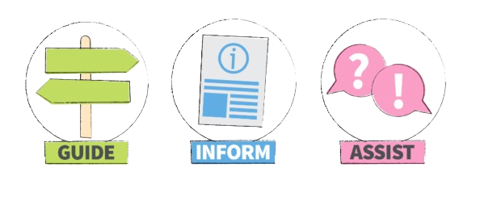
THE EUSS FOR NON-EEA CITIZENS
With Chris Benn, Seraphus
Tuesday, 23rd July 2024

Slide 2
JOINING FAMILY MEMBERS: REQUIREMENTS
The relationship between you (the applicant) and your EEA family member (your sponsor) must have begun by 11 pm on 31/12/2020 (31/12/2025 for family member of Swiss citizens). This does not apply to future children.
The relationship must still exist at the date of the application
The sponsor must be an EEA or Swiss national and have obtained their status based on their own rights of residence.
You must be your sponsor’s spouse or civil partner, durable partner, child/grandchild or dependent parent/grandparent.
You can apply even if you are the child or grandchild of your parent’s spouse or if you are the parent or grandparent of your child’ spouse - provided that they meet the requirements.
If you are applying as a dependent child aged 21 and over or as a dependent parent, you must prove to be dependent on your family member for financial or medical reasons.
Children under the age of 21 do not need to show dependency.
Non-EEA Joining Family Members

Slide 3
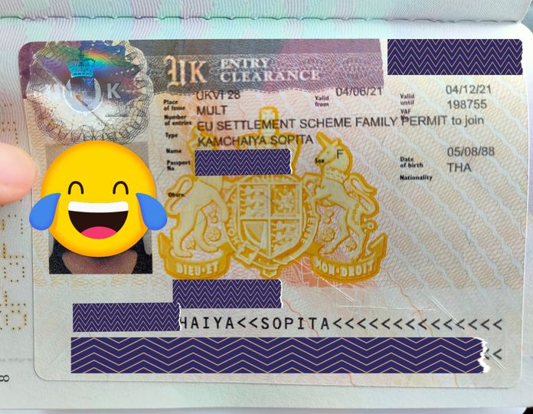
PROCEDURE
Apply for an EUSS Family Permit on the Gov.uk website: https://www.gov.uk/family-permit/apply-joining-family-member-eu-switzerland-norway-iceland-liechtenstein
Attend the biometric appointment at the dedicated TLScontact or VFS centre.
Enter the UK before the Family Permit expires.
Apply for pre-settled/settled status within 3 months from the date of arrival by selecting the option to send the passport to the Home Office.
Attend biometric appointment at UKVCAS centre.
If the application passes the validity assessment, you will receive a Certificate of Application (COA), that will enable you to live and work in the UK while you wait for a response.
An EUSS FP allows its holder to work and study in the UK until it expires... it usually expires after 6 months.
Non-EEA Joining Family Members

Slide 4
DEADLINE
There is no deadline for applying as a joining family member from abroad.
Applications for an EUSS Family Permit need to be submitted from abroad and you need to wait for the outcome before coming to the UK to join your family member.
If you have a child born in the UK after 01/04/2021 who is not British, you need to apply for pre-settled/settled status on their behalf within 3 months from their date of birth. If you apply after 3 months, it will be considered as a late application.
If you arrive in the UK with an EUSS Family Permit, you need to apply within 3 months from the date of arrival.
If you arrive in the UK with more than 3 months of validity on your Family Permit, you need to apply before the Family Permit expires. However, we still recommend that the application is made within 3 months of your arrival. If you apply after the expiry of your Family Permit and have been in the UK for more than 3 months, you will need to justify your reason for applying late.
Exceptional circumstances may allow a person who arrives in the UK lawfully and without an EUSS Family Permit to apply for pre-settled/settled status from the UK within 3 months from their date of arrival. If you are already in the UK and want to join a family member with pre-settled or settled status, please contact us!
?
Non-EEA Joining Family Members

Slide 5
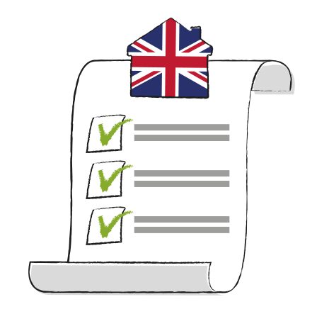
EVIDENCE: What do I need?
Valid passport
UAN (Unique Application Number) of the pre-settled/settled status of your sponsor
Evidence of the relationship with your sponsor
Evidence of the dependency if required
All evidence must be translated into English by a certified translator. Photos or scans of both the original document and of the translation should be provided.
Non-EEA Joining Family Members

Slide 6
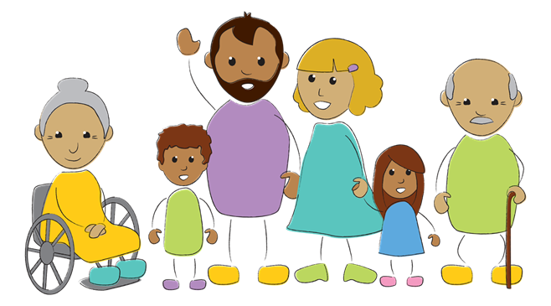
Proving dependency
De
Only children and grandchildren at the age of 21 and over and parents/grandparents need to prove dependency.
Dependency can be for financial or health reasons and can be a partial dependency too.
In both cases, it is necessary to show that the applicant depends on the sponsor or their spouse or civil partner (with marriage/civil partnership celebrated before 11 pm on 31/12/2020 or 31/12/2025 for family members of Swiss citizens).
If dependency is caused by the health condition of the applicant, it is necessary to show that the sponsor or spouse or civil partner provides the necessary care.
If due to financial reasons, that the sponsor or spouse or civil partner provides the financial support.
You need to show that without the financial or practical support of the sponsor, you cannot meet your essential living needs.
Examples of evidence: medical letters and examinations, money/bank transfers received regularly, receipt of monthly expenses (bills, rent, grocery, medicine etc).
A support letter can help to explain your situation.
Non-EEA Joining Family Members

Slide 7
“Lounes” EUSS applications

Slide 8
Are all dual EEA/British citizens “Lounes” cases?
A “Lounes” application under the EUSS comes from the family member of an EEA citizen who has become a British citizen after moving to the UK (and has retained their EEA nationality.
Lounes applications do not cover family members of:
Dual EEA/British nationals who are British from birth.
Dual EEA/British nationals who became British before their EU/EEA country joined the EU/became an EEA country.
Dual EEA/British nationals who were British before EEA.
To understand if a Dual EEA/British nationals can sponsor a family member’s Lounes application it is also important to understand their EU law position when they became a British national.
Presentation by www.seraphus.co.uk

Slide 9
How to know if Lounes applies
Practically this means that to understand if your can be sponsored as a Lounes family member, you will need to investigate the situation of your EEA/British sponsor before they became a British national.
They need to have been one of (or a mixture of)
A job seeker (for a limited time only)
A worker / employee
Self-employed
A student or self-sufficient person
It is also important to understand how long they fell under the above categories before they became a British national.
In some cases permanent residence under EU law would have acquired before becoming British.
Presentation by www.seraphus.co.uk

Slide 10
Making a Lounes application
A Lounes sponsor is technically called a “relevant naturalised British citizen” under the EUSS. The family member must apply:
On a paper application form obtained from the SRC if the family member is in the UK
Online for an EUSS Family Permit if the family member is outside the UK
Evidence for the EEA/British sponsor must be included in the application as well as evidence of the family relationship.
If Lounes does not apply or is unsuccessful then the family member will need to be sponsored under the UK family visa rules (noting that these are more restrictive and expensive than the EUSS and not all the family same relationships are covered).
Presentation by www.seraphus.co.uk

Slide 11
Durable Partner EUSS applications

Slide 12
Durable partners are unmarried partners (not in official registered relationships), whose relationship was serious (durable), by 31 December 2020.
Unless you already have a document issued under the EEA Regulations as a durable partner, the Home Office will carry out an assessment of the quality of the relationship to decide if it was durable by 31 December 2020.
Only relationships the Home Office accepts as durable by this date will be granted status under the EUSS.
Even if you are now married or in a civil partnership with your partner, if this did not take place by 31 December 2020 then you will have to show that you were in a durable relationship.
Presentation by www.seraphus.co.uk

Slide 13
The Home Office guidance states a durable partnership is one where “the couple having lived together in a relationship akin to a marriage or civil partnership for at least 2 years (unless there is other significant evidence of the durable relationship)”.
If the couple were living in the UK before 31 December 2020, the non-EEA partner must show their residence was covered by:
An EEA Regulations document (such as residence card or EEA Family Permit), or;
A grant of domestic immigration status (e.g. student visa).
If living together they should show evidence of cohabitation (non-exhaustive examples are bank statements, utility bills, residential tenancy or rental agreements or mortgage statements, official correspondence to them at the same address).
Presentation by www.seraphus.co.uk

Slide 14
If the couple have not been living together but were in a serious relationship by 31 December 2020 they can still qualify as durable partners however, there will need to be good evidence to show that the relationship existed and was serious.
Evidence that should be included:
Statements from the couple explaining the history of the relationship, including why you were not living together yet and your future intentions.
Evidence of travel to see each other.
Birth certificates of any children if applicable.
If the Home Office does not accept the evidence shows a durable relationship it may be possible to apply again if there is stronger evidence or, an appeal can be made to the Immigration Tribunal.
Presentation by www.seraphus.co.uk

Slide 15
From pre-settled to settled status: requirements (1)
1) Having completed a qualifying period of residence.
The standard duration is 5 years, but it may be longer in the case of absences or shorter under certain circumstances.
The qualifying period does not necessarily start on the day the applicant began living in the UK.
For non-EU citizens who started living in the UK as family members of an EU citizen, the qualifying period begins when they became family members of the EU citizen and before 31/12/2020.
For Joining Family Members, the qualifying period starts after 31/12/2020, the date the qualifying period starts depends on your situation.
Settled status for non-EEA citizens

Slide 16
Qualifying period: examples
Ali is a Tunisian citizen and has pre-settled status as the durable partner of Lucia, a Spanish citizen. Ali and Lucia met in Spain in 2016 and lived together for 3 years before Lucia moved to the UK in 2019. Ali joined her on 17/08/2019 with an EEA Family Permit and later obtained a Biometric Residence Card (BRC). Ali's qualifying period started on 17/08/2019, so he can apply for settled status from 17/08/2024, provided that he meets all the other criteria.
Elona is an Albanian citizen who arrived in the UK on 3/09/2022 with an EUSS Family Permit granted as the the Joining Family Member of Adriaan, a Dutch citizen. They married in Amsterdam on 5/01/2020. Once in the UK, Elona applied and obtained pre-settled status. Elona's qualifying period began on 3/09/2022, so she can apply for settled status starting from 3/09/2027, provided that she meets all the other criteria.
Settled status per i cittadini non-UE

Slide 17
From pre-settled to settled status: requirements (2)
2) Having maintained your continuous residence during your qualifying period.
3) The family relationship with your EU family member must still exist at the time of the settled status application.
If the relationship between you and your EU family member no longer exists, it is necessary to check if you can still apply for settled status.
The same applies if your EU family member no longer lives in the UK.
4) The EU family member must have obtained or applied for settled status.
5) Passing the “Suitability Assessment”: be mindful of criminal records in the UK and abroad.
Settled status for non-EEA citizens

Slide 18
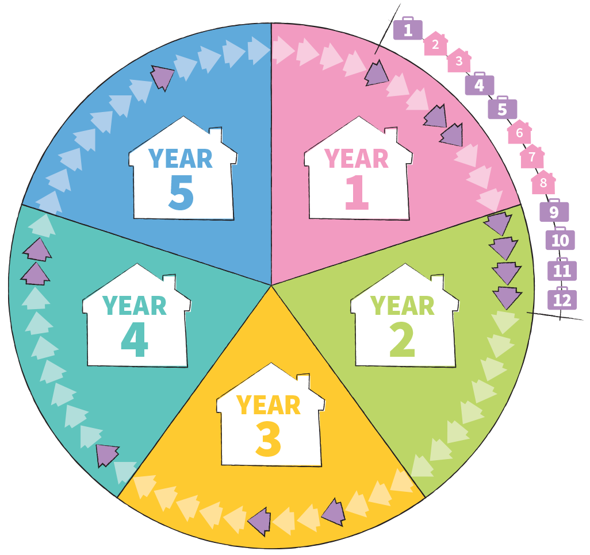
Continuous residence and absences
7/12 months
You must have lived in the United Kingdom for at least 6 months in each 12-month period of your qualifying period.
With absences exceeding 180 days in any 12-months period, continuous residence is broken unless an exception applies.
These 180 days are calculated as the total of all days of absence that occurred in ANY 12-months cycle within the qualifying period.
What counts is whether or not you were physically present in the United Kingdom. The days of departure and arrival are not considered days of absence. Once the qualifying period is completed, the counting of absences stops.
The calculation of absences must start from the same date as the beginning of the qualifying period.
Settled status for non-EEA citizens

Slide 19
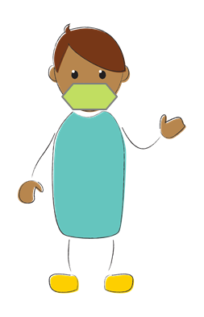
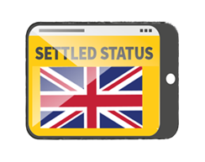
Exceptions to the “absences rule”
Covid-19
1
2
IMPORTANT
Covid-19
1 SINGLE ABSENCE Less than 12 months
1 SINGLE ABSENCE More than 12 months
OR
OR
2 ABSENCES
If you have been absent for more than 180 days but less than 12 months due to an important reason, you may still be eligible for settled status. At the end of your 5 years of continuous residence, when you apply, you need to submit a letter explaining your situation along with evidence to justify the absence. Examples of "important reasons" include: Covid-19, work assignments, childbirth, serious illness, professional training. The final decision is at the discretion of the caseworker.
An absence of more than 12 months and less than 24 months is allowed only if due to reasons related to Covid-19, such as being prevented or advised not to return because of Covid-19.
You may still be eligible for settled status, but your qualifying period will last longer than 5 years.
If you have already had a long absence for an important reason, you can justify another absence as long as at least one of them was due to Covid-19 and the other for a different important reason unrelated to Covid-19.
In this case, the qualifying period will last longer than 5 years.
When an absence is justified, those days are excluded from the calculation of absences.
Settled status for non-EEA citizens

Slide 20
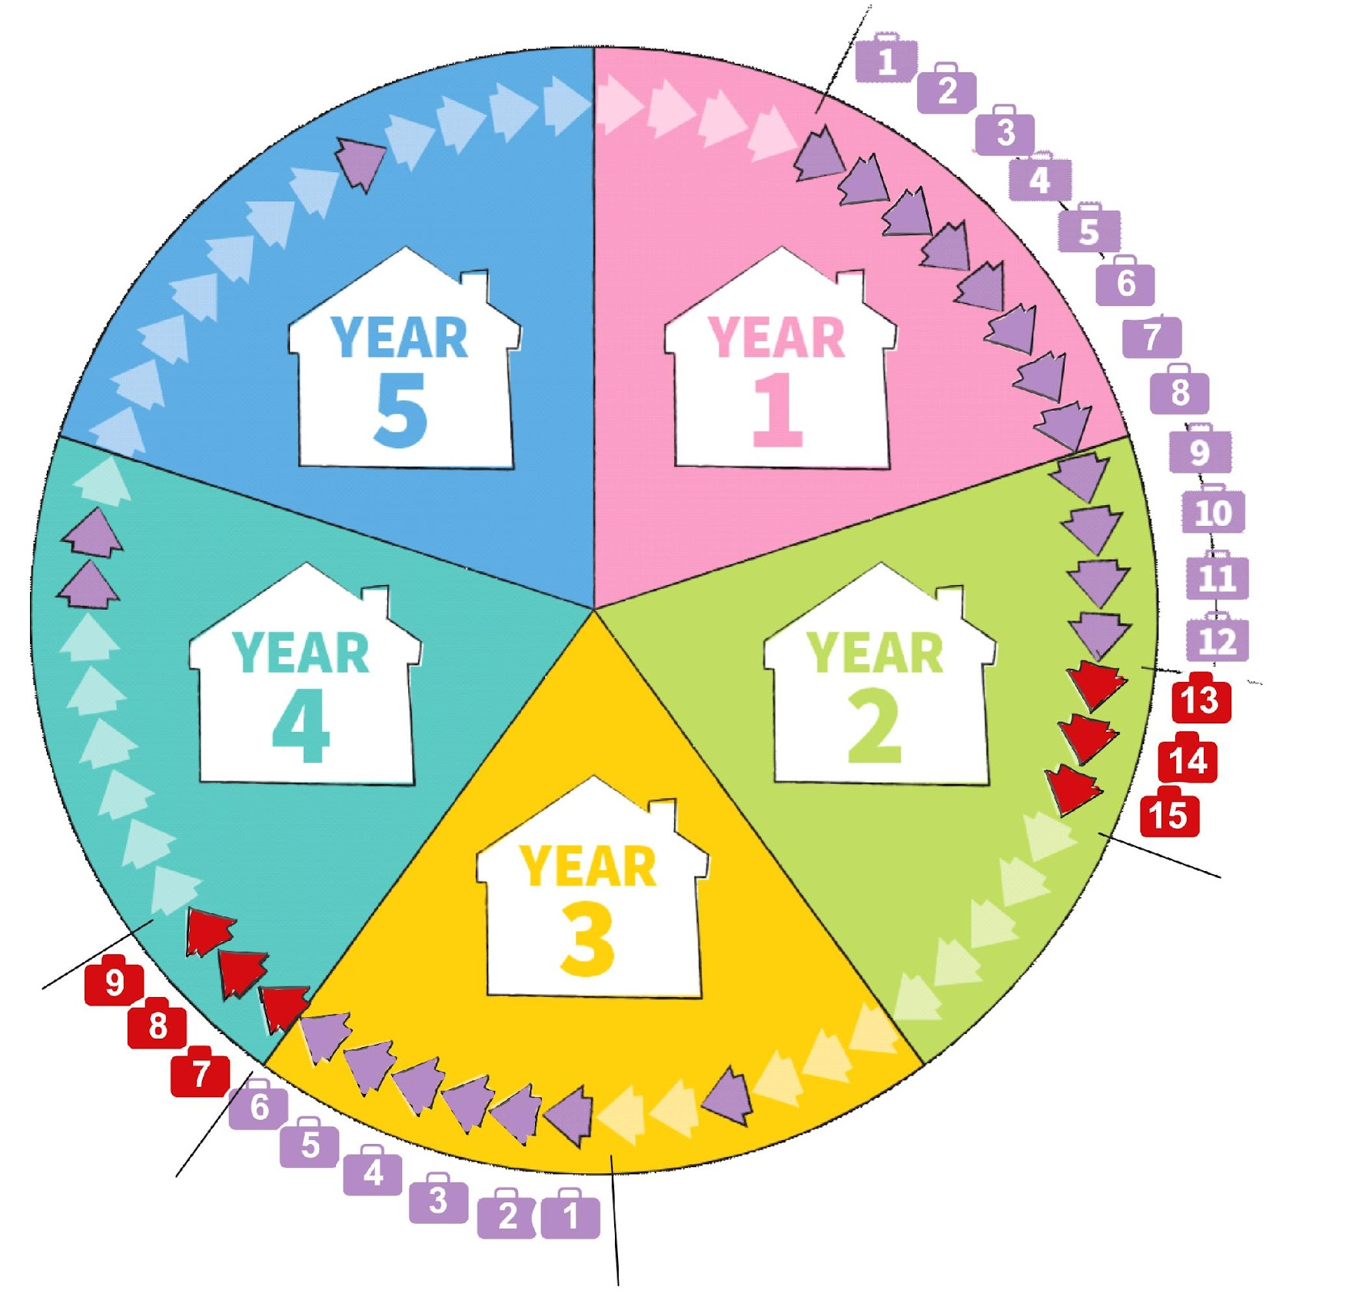
The effect of absences on the qualifying period
2 absences exceeding 6 months
If there are two absences, one must be due to Covid-19.
For the first absence: only the first 12 months of absence can count towards your 5 years of continuous residence.
For the second absence: only the first 6 months of absence can count towards your 5 years of continuous residence.
You can apply for settled status if you can demonstrate that you have lived in the UK for 5 years + X months, where X is the number of "excess" months.
If your pre-settled status does not cover your extended qualifying period, you will not need to apply for pre-settled status again.
The Home Office will automatically grant a 5-year extension to pre-settled status holders who did not apply for settled status before the expiry of their pre-settled status. This will happen before the pre-settled status expires.
Mary arrived in the UK in March 2019 and has pre-settled status valid from April 2020 to April 2025.
She has a 13-month window to apply for settled status.In 2020, due to Covid-19, Mary went to Germany and returned after 15 months in 2021. In 2022, her employer sent her abroad for 9 months.
Mary has 3 months in "excess" from her first absence and will have another 3 months in "excess" from her second absence. Fortunately, her pre-settled status covers her entire qualifying period.

Slide 21
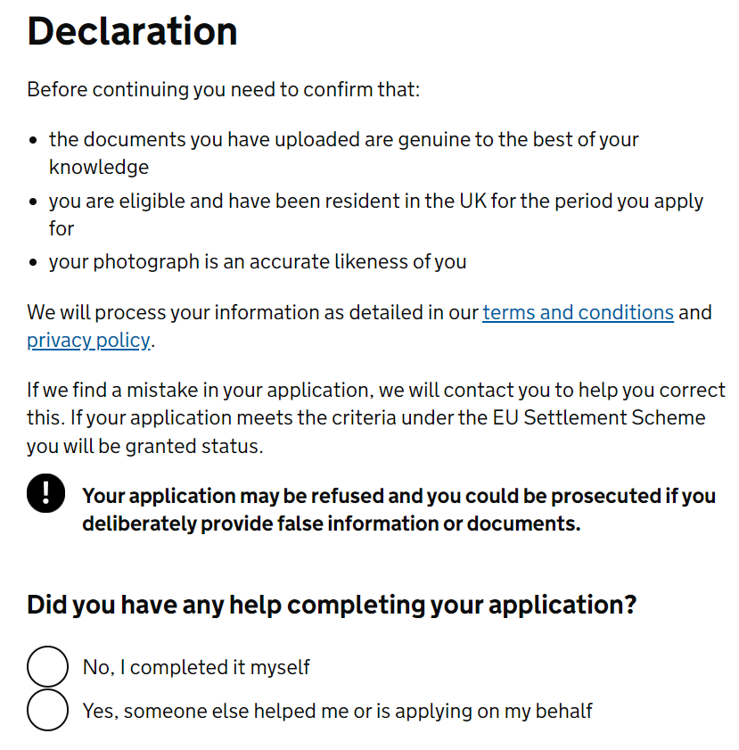
Be careful !
When applying for settled status, you take responsibility for the statements made to the Home Office, regardless of previous emails, automatic checks, internal records, or other circumstances.
It's important to be precise and tell the truth.
Receiving generic emails from the Home Office does not guarantee that you will receive an extension of pre-settled status, or that you have accrued the right to settled status, or any other status.
Home Office said that they will start granting settled status automatically to those that have continuous records for at least 5 years with DWP or HMRC, this will not apply to non-EEA citizens.
Do not wait for an extension of pre-settled status.
Apply for settled status as soon as you meet the requirements (and not before!).
Settled status for non-EEA citizens

Slide 22
Procedure
You need to submit a new application.
You can start by scanning your Biometric Residence Card (if valid) using the EU Exit: ID Document Check app.
Alternatively, you can apply by filling out the online application and selecting the option to send your valid passport by post.
Fill the online application and attach the evidence required.
You will not receive a Certificate of Application.
Patiently wait for the outcome, waiting times vary.
Settled status for non-EEA citizens

Slide 23
Evidence: what do I need?
National Insurance Number (NIN), which is useful for checks on continuous residence.
If requested, you must upload proof of residence covering at least 6 months for every 12-months period:
Council Tax and utility bills;
Payslips, P60s and P45s;
NHS, GP letters;
Bank statements showing physical transactions in the UK;
Tenancy Agreements and mortgage statements only if accompanied by proof of payment.
Unique Application Number (UAN) of your pre-settled status.
UAN of the settled status of your EU family member.
Evidence of the relationship with your EU family member, such as birth or marriage certificate, it depends on the relationship with them.
Evidence to justify a long absence and support letter if necessary.
You should provide scans or pictures of original documents
Screenshots of documents are not accepted
Settled status for non-EEA citizens

Slide 24
Upgrading to Settled Status

Slide 25
When to apply for settled status
The general EUSS rule is that pre-settled status holders can apply for settled status after 5 years of continuous residence.
The 5 years continuous qualifying period (CQP) is calculated from the beginning of UK residence as a family member not from the grant of pre-settled status (e.g. could begin earlier than the grant).
There are some exceptions to the 5 year residence rule:
Children (EEA or non-EEA) whose EEA parent has been granted settled status can immediately apply for settled status.
EEA citizens who have ceased activity (which means they stopped working because of accident or illness, retired or moved overseas to work but continue to live in the UK). Their EEA or non-EEA family members can also apply early.
Presentation by www.seraphus.co.uk

Slide 26
Family member evidence
In addition to showing they have completed a 5 years CQP, (joining) family members must also show that they still have an EEA sponsor, or had a sponsor for 5 years to be eligible for settled status.
Unless the applicant is a former family member who is relying on retained rights of residence, in which case there is no need to provide evidence for the EEA sponsor from when the right arises.
Unless relying on retained rights of residence, evidence of the EEA sponsor’s position will be needed (e.g. that they have been granted settled status and potentially residence evidence).
Dependency where relevant should not be retested.
Primary carers (and their children) of self-sufficient EEA children and of children of EEA citizens who are in education in the UK, need to prove this situation continued for five years.
Presentation by www.seraphus.co.uk

Slide 27
Retained rights of residence
There are several situations where a non-EEA national can retain the right of residence:
Their EEA sponsor dies (and they were resident in the UK for 1 year before their death).
A child of an EEA sponsor who died or left the UK and are education in the UK (or are the parent of such a child).
The spouse or civil partner of an EEA sponsor whose relationship has legally ended (if they meet other conditions relating to residence, care of children or are a victim of domestic abuse). The existing family unit is also covered.
The family relationship with an EEA sponsor has broken down permanently because of domestic violence of abuse.
Presentation by www.seraphus.co.uk

Slide 28
Taking legal advice
It is very likely that if you are trying to move from pre-settled status to settled status and you do not have the support of your EEA sponsor then you will need to take regulated advice.
This is because the criteria to successfully move to settled status is likely to be complicated and the evidence that needs to be submitted will need to show how you are eligible.
In some cases a non-EEA pre-settled status holder may not be able to progress to settled status even if they have been living in the UK continuously for 5 years.
If this situation arises it will be important to investigate if there are any alternative immigration routes available to remain in the UK.
Presentation by www.seraphus.co.uk

Slide 29
Expiry of Biometric Residence Cards

Slide 30
What are BRCs?
non-EEA nationals granted status under the EUSS will have a Biometric Residence Card (BRC), either:
Issued under EU free movement rules (the EEA Regulations)
Issued under the EU settlement scheme
non-EEA nationals are also provided “digital status” in a UKVI account which is accessed on GOV.UK using the status holder’s ID document (e.g. passport). This is also called an eVisa.
In the UK non-EEA nationals can rely on their digital status to prove their rights such as the right to work, rent property, access benefits, access the NHS etc, by using the View and Prove service.
Generally for travel, non-EEA nationals need to show their BRC to airlines, Eurostar and ferries to be able to travel back to the UK
Presentation by www.seraphus.co.uk

Slide 31
Why do BRCs expire?
Most BRCs will have an expiry date of 31 December 2024, even though they EUSS status will not expire on this date (settled status has no expiry date).
The reason why BRCs are set to expire on this date is because the Home Office intends to operate a digital only immigration system.
This means proving immigration status will be from UKVI accounts using the View and Prove service and automatic digital status checks in some cases.
The current plan is BRCs will no longer be accepted as proof of EUSS status from 01 July 2025.
However, if your BRC expires before 31 December 2024 then you need to replace it if you want to travel outside the UK.
Presentation by www.seraphus.co.uk

Slide 32
Do I need to do anything about my BRC?
You may hear talk about how all people with immigration status need an eVisa before 2025.
Do not worry because if you have pre-settled or settled status then you have an eVisa (your UKVI account) and so you do not need to get an eVisa.
However, it is important that you keep your UKVI account up to date - particularly with a new passport - to ensure that you do not have any problems proving your rights.
You can update your UKVI account online at GOV.UK.
If you have any issues with your UKVI account you should contact the Home Office Settlement Resolution Centre.
Presentation by www.seraphus.co.uk

Slide 33
Do you need our help?
advice@settled.org.uk
applyeusswales@settled.org.uk
0330 223 5336
www.seraphus.co.uk

